Slide 1

Checkpoint Project
GO MY CODE
Ali lahmar

Slide 2
How does the web works?
Devices connected to the internet are divided into:
Request
Clients
&
Servers
Responses
Clients: are the browsers that request and render web content like chrome,firefox and the applications
Servers: are the applications their function is to deliver web content or services to the client through a specific programming interface API

Slide 3
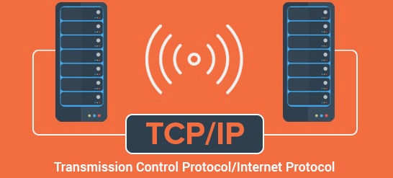
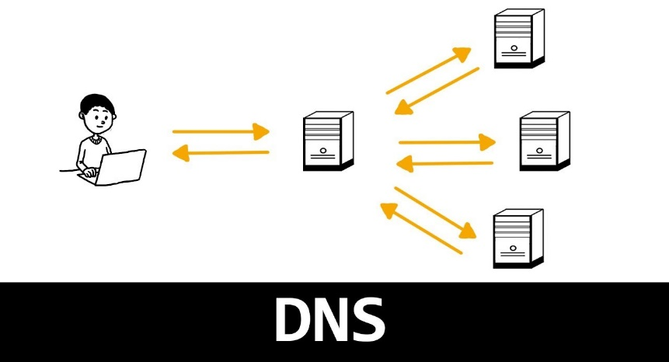
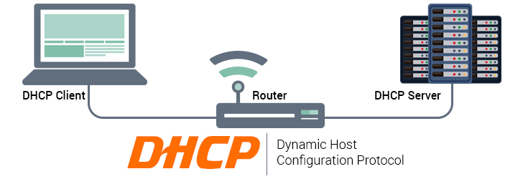
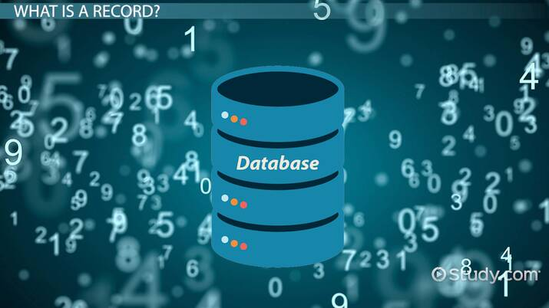

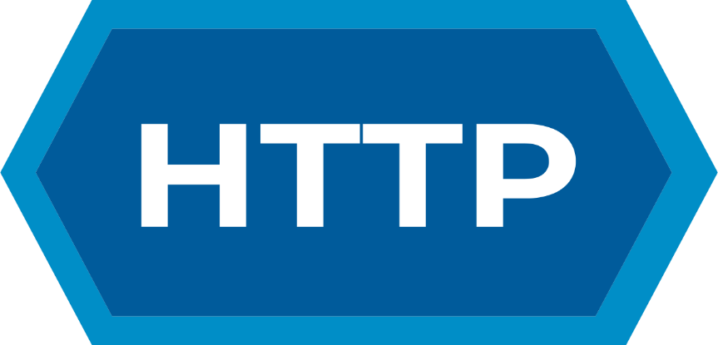
But the clients and servers we discussed before not enough, they did not tell us whole the story there are many other parts involved to make the web works:

Slide 4
TCP/IP: Transmission control protocol and Internet protocol
They are two communication protocols that define how data travels over the web is categorized as a « transport layer »,
DNS: Domain name system
Like an address book for websites, the browser searches the DNS to find the real website adress before it can retrieve the website,

Slide 5
DHCP: Dynamic host configuration protocol
Is a protocol that automatically assigns a unique IP address to each device that connect to a network
API: Application programming interface
Which is a software intermediary that allows two applications to speak to each other like facebook send an instant message.
There are a lot of types:
Open API
Partner API
Internal API
CompositeAPI
There a lot of web services API but the best known is:
Rest API

Slide 6
HTTP methods/verbs: Hyper text transfer protocol
Defines a set of query methods that indicate the action that we want to perform on the indicated resource and it can be shared by different methods
Trace
Get
Option
Connect
Patch
Head
Delete
Post
Put

Slide 7
DATABASES:
Is a systematic collection of data that make data management easy.
DATABASES TYPES:
Relational databases / object-oriented databases / distributed databases / data warehouse / NOSOL databases / graph databases / OLTP databases.cv
QSL: structred query language
NOQSL: Not only QSL
It is a language that allows communication with databases in order to manage all the data they contain.
It is an approach to database design that provides flexible schemas for the storage and retrieval of data beyond traditional table structures found in relational databases.

Slide 8
So what happens
When you request a web page address from your browser for example (https://gomycode.com) the following occurs:
The browser asks the DNS server for the real address of the server on which the site lives.
The browser uses this address to send a message to the server using the HTTP protocol, and asks for it to send a copy of the website to the client. This message and all other data sent between the client and the server are sent over your internet connection using TCP / IP.
In the event that this service or page is available at the server, and according to the HTTP protocol, the server will respond to the request with the answer or success, and then begin to transfer and send the page file or data in the form of a series of small data packets, browser collects these packages in the form of one file again and displays them as appropriate.

Slide 9
What do you need to be a developer ?
Being a developer requires many skills and knowledge need to study like :
Front-end:
HTML
CSS
JAVASCRIPT
Back-end:
Node js
Express js
Mongo DB
GIT
Fullstack:
To know program a browser hmtl
program server like PHP ASP PYTHON OR NODE
program database like SQL SQLITE MONGODB

Slide 10
What is the role of a web developer ?
The role of a web developer is responsible for designing, coding and modifying websites from layout to function and according to a client’s specifications.

Slide 11
Thank you for your attention

